Slide 1
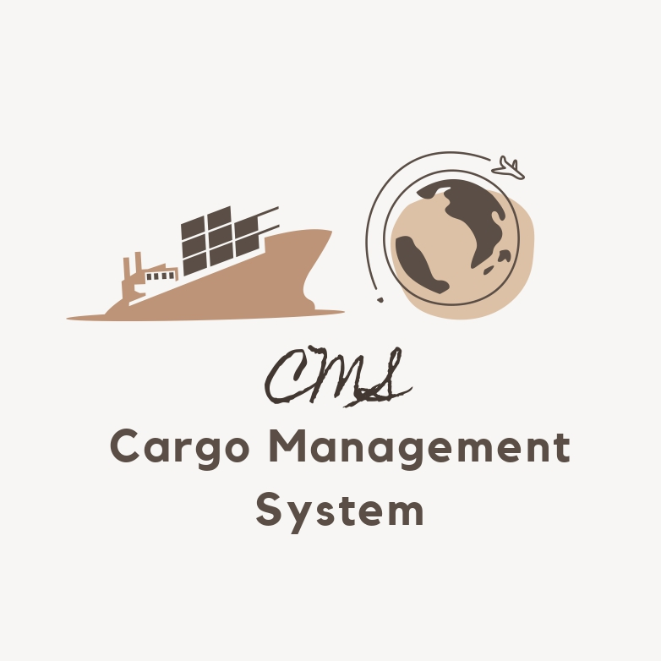
SOFTWARE ENGINEERING AND PROJECT MANAGEMENT(18CSC206J)
TITLE - CARGO MANAGEMENT SYSTEM
By Shridhar Surada(RA2011031010132)
Aditya Balaji Yalavarthy(RA2011031010120)
Maniveer Reddy(RA2011031010127)

Slide 2
PROJECT DESCRIPTION
The cargo management system is an application that will help in maintaining the cargo trading either through ship or locally.
This application can be used by the cargo company to know about the cargo quantity that is managed within its warehouse, price of the cargo, availability of the cargo and many other features. This application can drastically reduce the pen paper work as it can be automated.
It can also help in storing the information in an easier way.
The data can be stored easily through this application. The user interface will be simple and user friendly.

Slide 3
THE HISTORY
To automate all activities of cargo tracking in cargo management.
Designing a system to eliminate the current manual system of filing, file retrieval problem, and file processing and delivery of progress details to clients.
Records the cargo events from the source location to destination location.
To determine the extent to which an online cargo tracking system will help both management and clients.

Slide 4
GOALS
This focuses on providing the exact and correct live location of the container in any means of transport. It offers number of benefits including:
1. Providing status of the cargo to user.
2. Collecting goods information from several clients, and can record and maintain delivery information

Slide 5
PROJECT METHODOLOGY
WE HAVE USED AGILE METHOD FOR OUR PROJECT CARGO MANAGEMENT SYSTEM.
AGILE METHODOLOGY:
Agile methods were seen initially as best suitable for non-critical service and product domains, thereby barred from use in regulated fields such as cargo systems and managements, financial, nuclear systems, automotive, and avionic sectors etc. however, recently there have been some drives for the adoption of agile methods for nontechnology domains.

Slide 6
FUNCTIONAL AND NON FUNCTIONAL REQUIREMENTS
SYSTEM REQUIREMENTS:
Hardware:
System- intel core above i3.
Hard disk- min. 8gb Software:
Operating system- windows 8/9/10/11
Language- python
Tools- latest version of visual studio.

Slide 7
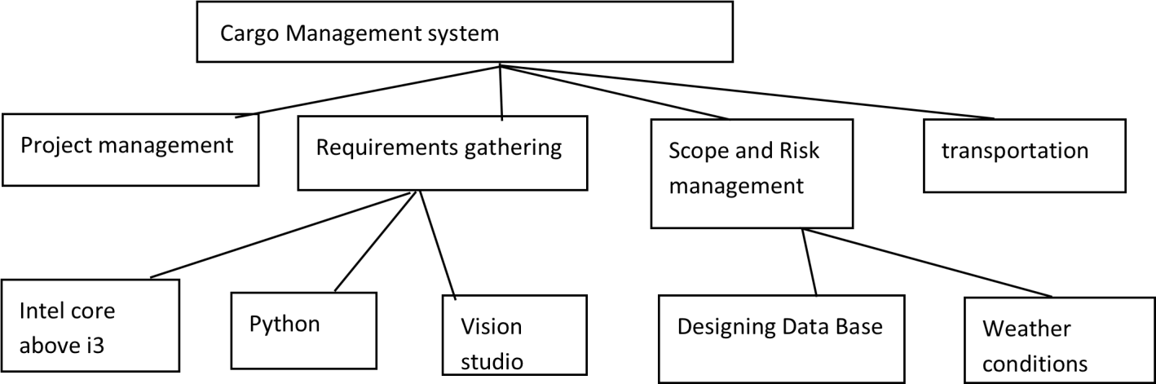
WORK BREAK DOWN STRUCTURE

Slide 8
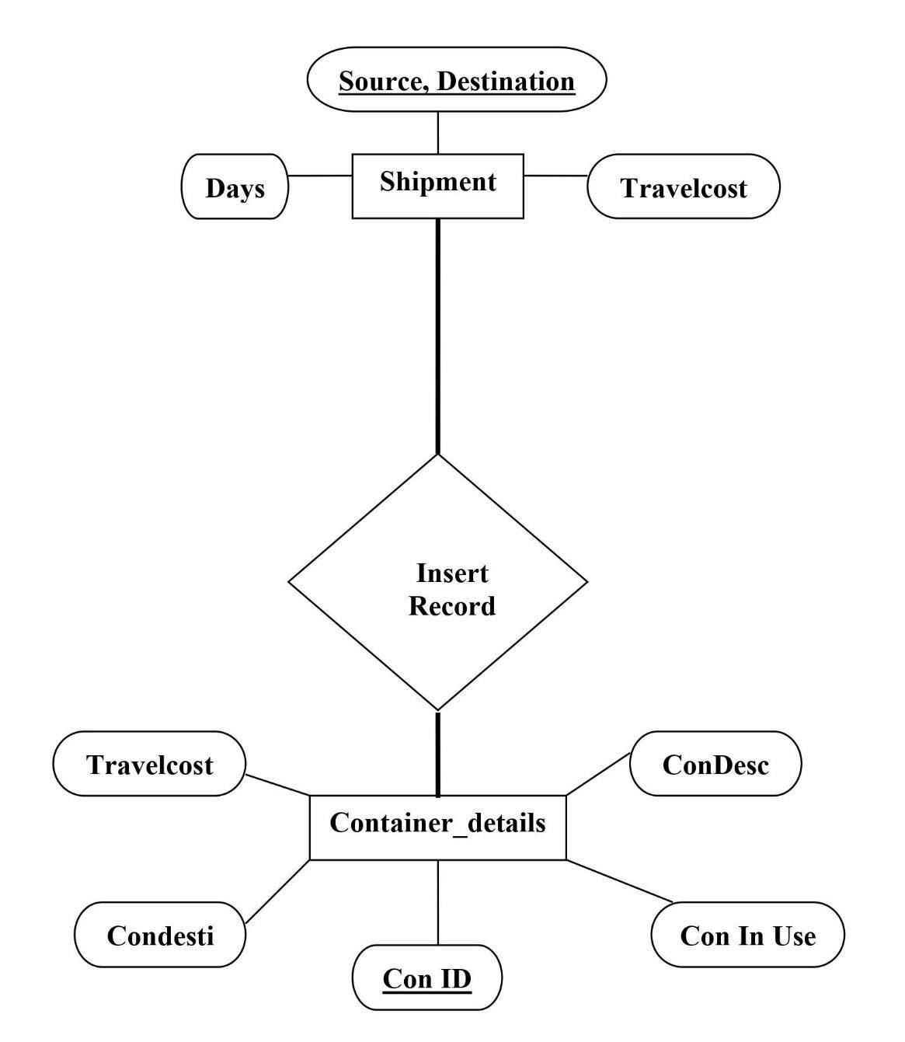
ENTITY RELATIONSHIP DIAGRAM

Slide 9
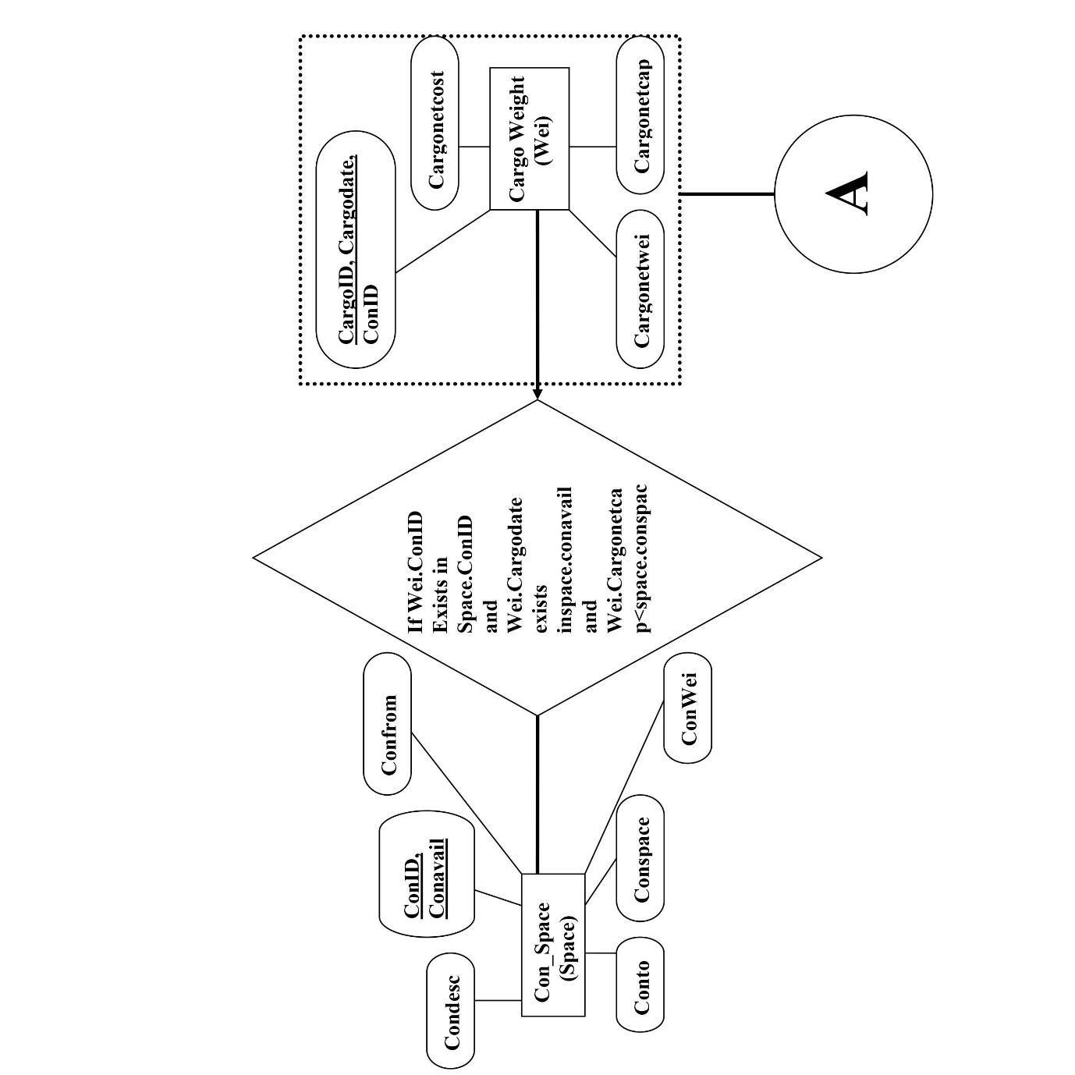
COLLABORATION DIAGRAM

Slide 10
Test Plan
Functional:
Dynamic web interface
System authorities.
Personal information.
Cargo information
The system shall support multiple

Slide 11
Non-Functional:
Performance
Availability
Scalability
Confidentiality
Compliance
Usability
Reliability

Slide 12
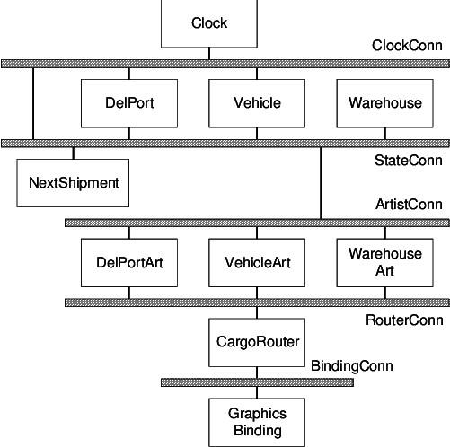
ARCHITECTURAL DESIGN

Slide 13
LIMITATIONS
Cost of tracking devices
The Time delay due to weather conditions.
The cargo should be delivered without any damages.
The safe shipment of the cargo from roadways to ships or airplanes.

Slide 14
BENEFITS
Collecting goods information from several clients, and can record and maintain delivery information.
Maximized cost saving.
Less worrying for the customers because they can track their cargo.
Superior customer service.

Slide 15
THANK YOU!

